Slide 1
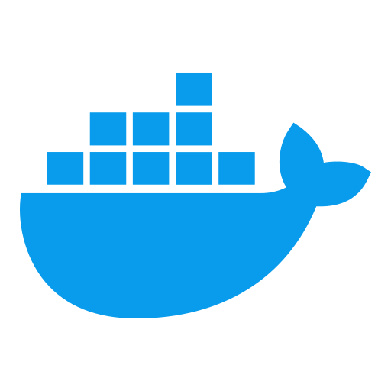
MODULE 3: DOCKER CONTAINER FUNDAMENTALS
Docker & Containerization Workshop
By TALHA

Slide 2
Learning Objectives
Master container lifecycle management using Docker commands
Develop proficiency in container debugging and troubleshooting
Implement container resource constraints and monitoring

Slide 3
Container Lifecycle Overview
Container States and Transitions
Created → Running → Paused/Stopped → Deleted
Exit Codes and Troubleshooting
0: Success, 1-125: Application error, 126-127: Command issues, 128+n: Fatal signals
Restart Policies
no, always, unless-stopped, on-failure[:max-retries]

Slide 4
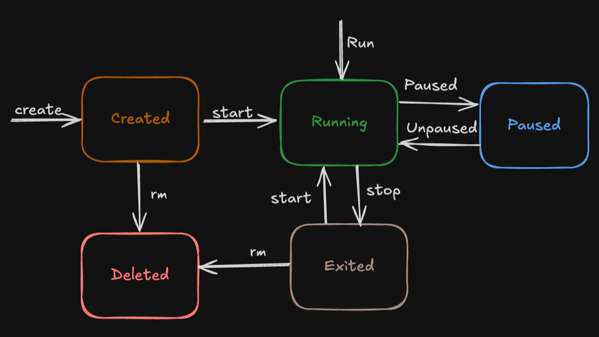
Container Lifecycle Overview

Slide 5
Essential Container Commands
Basic Container Management
docker ps [-a] # List running/all containers
docker inspect # View detailed configuration
docker logs # View container output
docker stats # View resource usage
Lifecycle Control
docker create # Create container without starting
docker start/stop # Start/stop a container
docker pause/unpause # Pause/resume container
docker rm # Remove container

Slide 6
Docker Run Deep Dive
Command Structure
docker run [OPTIONS] IMAGE [COMMAND] [ARG...]
Common Options
-d/--detach: Run in background
-i/--interactive -t/--tty: Interactive terminal
-e/--env: Environment variables
-p/--publish: Port mapping
-v/--volume: Mount volumes
--name: Container name
--restart: Restart policy

Slide 7
Docker Run Examples
Basic Usage
# Interactive terminal
docker run -it ubuntu bash
# Background service with port mapping
docker run -d --name web -p 8080:80 nginx
# With environment variables and restart policy
docker run -d --restart unless-stopped \ -e DB_HOST=db -e DB_PASS=secret my-app

Slide 8
Container Interaction & Inspection
Executing Commands
# Run command in running container
docker exec -it container_name bash
# Get detailed configuration
docker inspect container_name
# Format specific information
docker inspect --format='{{.State.Status}}' container_name

Slide 9
Container Logging
Log Retrieval and Options
# View logs
docker logs container_name
# Stream logs
docker logs --follow container_name
# Last n lines
docker logs --tail=100 container_name

Slide 10
Container Resource Management Overview
Why Limit Resources?
Prevent container monopolization
Ensure predictable performance
Optimize resource allocation
Support multi-tenant environments
Key Resources to Manage
Memory, CPU, I/O, PIDs (processes)

Slide 11
Memory and CPU Management
Memory Constraints
#Hard limit of 1GB with soft limit of 750MB
docker run -d --memory=1g --memory-reservation=750m postgres
CPU Constraints
# Limit to 0.5 CPUs (50%)
docker run -d --cpus=0.5 nginx
# Assign to specific CPU cores
docker run -d --cpuset-cpus="0,1" nginx

Slide 12
I/O and Process Constraints
I/O Throttling
# Limit write speed to 10MB/s
docker run -it --device-write-bps /dev/sda:10mb ubuntu
Process Limits
# Max 50 processes, custom file descriptor limits
docker run --pids-limit=50 --ulimit nofile=1024:2048 nginx

Slide 13
Container Shell Interaction Techniques
Attachment vs Execution
# Attach to main process (Ctrl+P, Ctrl+Q to detach)
docker attach container_name
# Create new process
docker exec -it container_name bash
Process Limits
SIGTERM (graceful): docker stop
SIGKILL (immediate): docker kill
Custom signal: docker kill --signal=SIGUSR1 container_name

Slide 14
Environment Configuration
Environment Variables
# Direct definition
docker run -e VAR1=value1 -e VAR2=value2 image
# From file
docker run --env-file=config.env image
Configuration Files
# Mount config file as read-only
docker run -v /host/config.json:/app/config.json:ro image

Slide 15
Container Debugging Techniques
Process Inspection
docker top container_name
docker exec container_name ps aux
Network Diagnostics
docker exec container_name ping host
docker exec container_name netstat -tuln
Common Debugging Tools
procps, iproute2, net-tools, curl, strace

Slide 16
Common Failure Patterns
Container Won't Start
Command failures, missing dependencies, resource constraints
Container Exits Immediately
Foreground process completion, configuration issues, crashes
Container Performance Issues
Resource contention, I/O bottlenecks, network problems
Debugging Approach
Check logs: docker logs container_name
Inspect configuration: docker inspect container_name
Check resource usage: docker stats container_name
Execute diagnostic commands: docker exec -it container_name bash

Slide 17
Container Monitoring and Health
Built-in Monitoring
docker stats # Real-time resource usage
docker events # Container lifecycle events
Health Checks
HEALTHCHECK --interval=30s --timeout=3s --retries=3 \
CMD curl -f http://localhost/ || exit 1 # In Dockerfile
docker run --health-cmd="curl -f http://localhost/ || exit 1" \ --health-interval=30s nginx # At runtime

Slide 18
External Monitoring & Cleanup
Monitoring Integration
Prometheus + cAdvisor for metrics
ELK/EFK stack for centralized logging
Container Garbage Collection
# Remove stopped containers
docker container prune
# Remove all unused objects
docker system prune

Slide 20
Hands-on Exercise: Container Lifecycle Management
Exercise Steps
Create containers with different configurations
Explore lifecycle states and transitions
Practice using container commands
Implement restart policies
Validate volume data persistence
Use inspection and logging tools

Slide 21
Hands-on Exercise: Resource Management
Exercise Steps
Create containers with resource constraints
Generate load to test constraints
Monitor resource utilization
Troubleshoot resource constraint issues
Optimize resource allocations

Slide 22
Key Takeaways & Next Steps
Container lifecycle management is essential for operational control
Resource constraints prevent container interference
Effective debugging requires systematic investigation
Monitoring provides visibility into container health
Proper cleanup prevents resource leaks
Next Module: Docker Images & Registries

Slide 23
Key Takeaways
Containers provide lightweight, efficient application packaging
Docker ecosystem offers standardized, portable containerization
Containerization enables faster deployments and better resource utilization
Enterprise transformation requires technical and organizational adaptation
Domain-specific applications benefit from containerized architecture

Slide 24

Questions?

